Slide 1
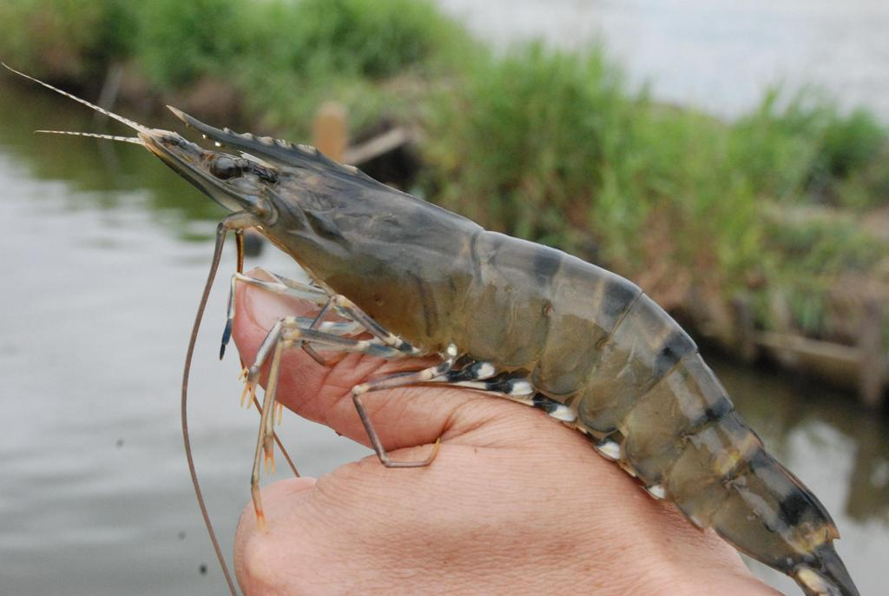
BROODSTOCK AND HATCHERY MANAGEMENT OF
Penaeus monodon
SHRUTI GUPTA
NCAAH

Slide 2
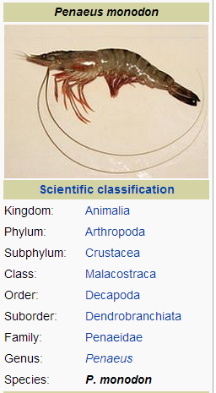
Penaeus monodon
Marine crustacean.
Its natural distribution :
Indo-Pacific, ranging from the eastern coast of Africa and the Arabian Peninsula, as far as Southeast Asia, the Sea of Japan, and northern Australia.
Females can reach approximately 33 centimetres long.
Males are slightly smaller at 20–25 cm long.
Life span= 1-2 yrs.

Slide 3
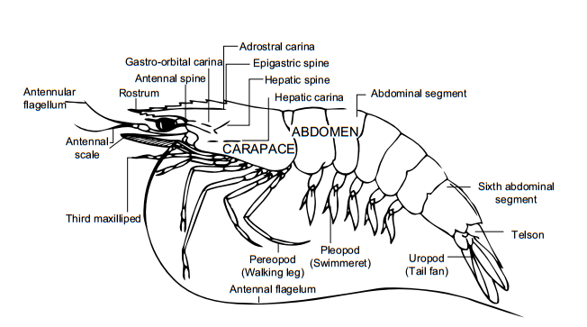
BIONOMICS & LIFE HISTORY
Lateral view of P. monodon showing important parts

Slide 4
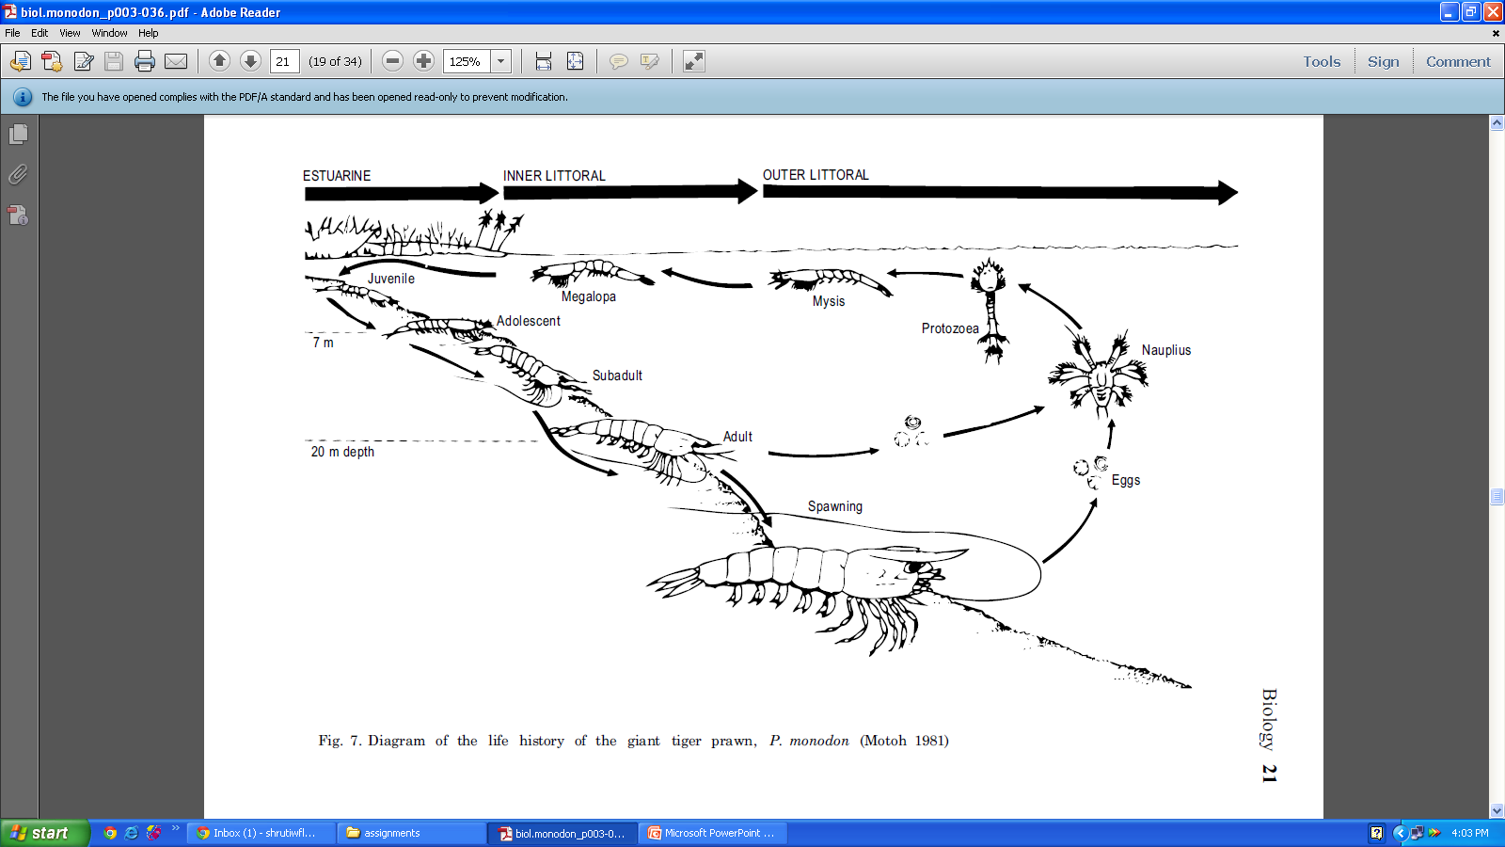
Life history of P. monodon

Slide 5
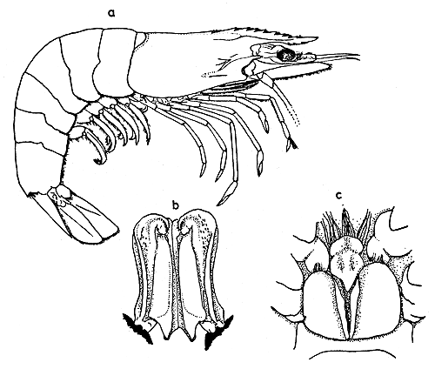
MALE REPRODUCTIVE ORGAN
FEMALE REPRODUCTIVE ORGAN
PETASMA
THELYCUM

Slide 6
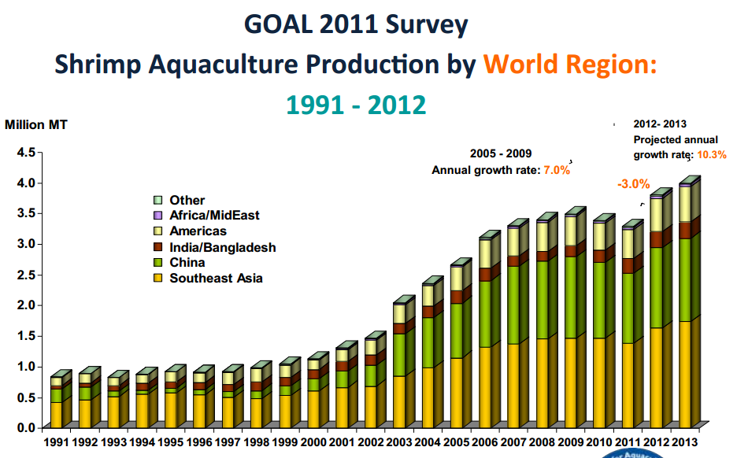
Penaeus monodon is the most widely cultured prawn species in the world.

Slide 7
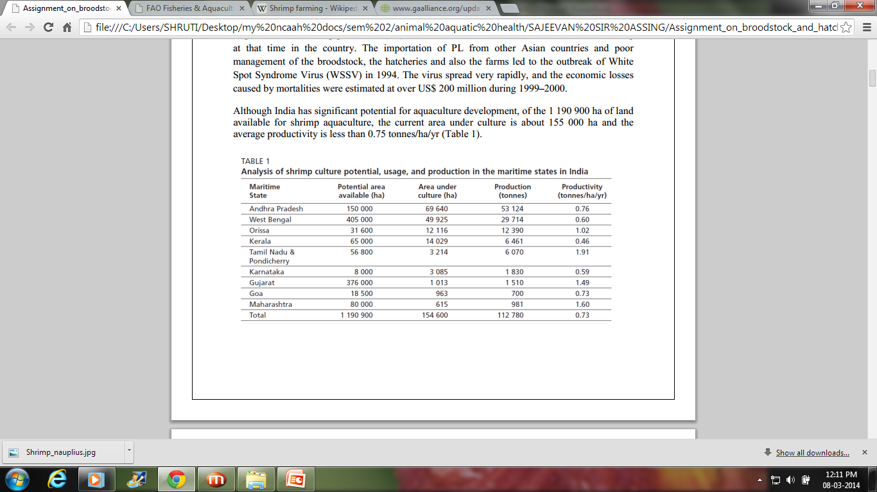
India has significant potential for aquaculture development, of the 1 190 900 ha of land available for shrimp aquaculture, the current area under culture is about 155 000 ha.

Slide 8
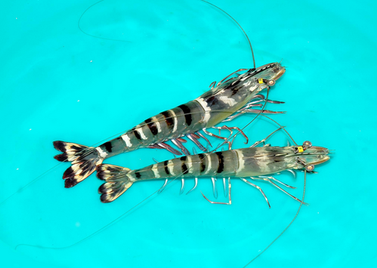
BROODSTOCK MANGEMENT
Broodstock, are a group of mature individuals used in aquaculture for breeding purposes.
Broodstock management involves manipulating environmental factors.
Major advantage : Holding broodstock in an accessible pond or tank offers readily available breeding adults whenever required.

Slide 9
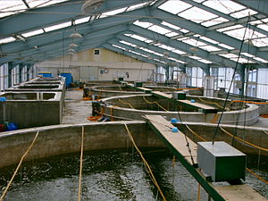
HATCHERY DEVELOPMENT
A hatchery is a resource where eggs are incubated and hatched.
In a hatchery mostly care for the young animals in their first few days or weeks of life is taken, until they are healthy and old enough to be shipped to another location.
Hatchery development involves cultivation and breeding of large number of fishes in an enclosed environment.

Slide 10
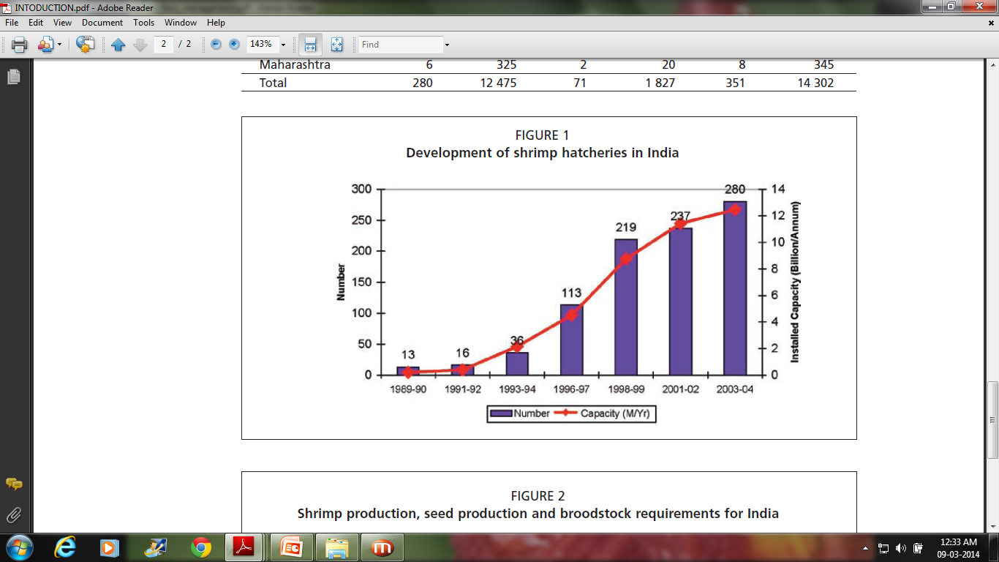

Slide 11
THE OVERALL BROODSTOCK &HATCHERY MANAGEMENT IN
P. monodon CAN BE DIVIDED INTO 2 BROAD CATEGORIES:
Pre- spawning procedures
Post- spawning procedures
Broodstock capture/ selection
Brooder maintenance/Nutrition
Broodstock holding /managing techniques
Broodstock maturation
Broodstock Spawning
Egg hatching
Disease test and transfer of eggs
Larval rearing unit preparation & management
Larval nutrition and health management
Testing/selection of post larvae (PL) for stocking
PL harvest and transportation
Nursery rearing facilities

Slide 12
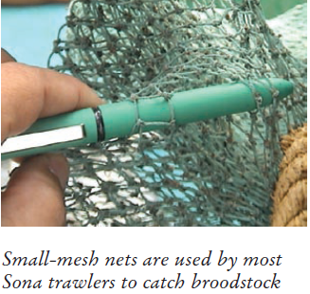
Pre- spawning procedures
Broodstock capture/selection
Wild-caught fish & Farm-reared fish.
Dependent upon wild broodstock.
Obtained as by-catch from shrimp trawling and by the use of specialized traps (nets having mesh size larger than the 1 cm).
Fishermen require training in selecting the right quality broodstock and in handling, storage and transportation techniques.

Slide 13
CONT….
The broodstock selection is based only gross examination. Some of the criteria include:
Lack of red coloration;
Clear gill coloration;
Absence of black spots;
Absence of gill fouling;
Lack of obvious white spots

Slide 14
Brooder maintenance/Nutrition
A good diet and feeding protocol for broodstock are key factors in the production of good-quality nauplii (shrimp larvae).
Emphasis should be placed on feeds offering similar polyunsaturated fatty acid (PUFAs such as arachidonic, eicosopentaenoic and decasohexaenoic acid).
Feed, fresh high quality feeds comprising live polychaete bloodworms (Glycera sp.),fresh squid (Loligo sp.),live but deshelled bivalve molluscs or clams (Meritrix sp.).
Frozen adult Artemia (brine shrimp) biomass and krill are other alternatives.

Slide 15
CONT..
Fresh feeds need to be chopped to a size suitable for ingestion.
Offered throughout the day (six times).
Alternatively artificial/formulated feeds with vitamin, mineral, pigment (astaxanthin or paprika), immunostimulant and PUFA supplements may also be offered to ensure good egg quality.
In order to maintain water quality, high rates of water exchange should be used.

Slide 16
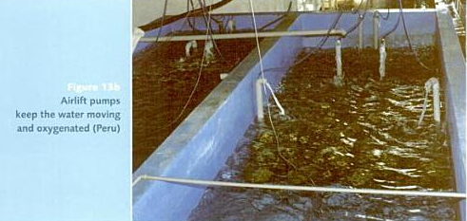
Broodstock holding techniques
Special broodstock ponds/Tanks are maintained.
To conserve water & good water quality, a recirculatory system is suggested.
The tanks need to be covered to exclude light & the interior should be painted with epoxy-resin paint.
Proper Aeration should be provided (Airlift pumps).
Photoperiod, temperature.

Slide 17
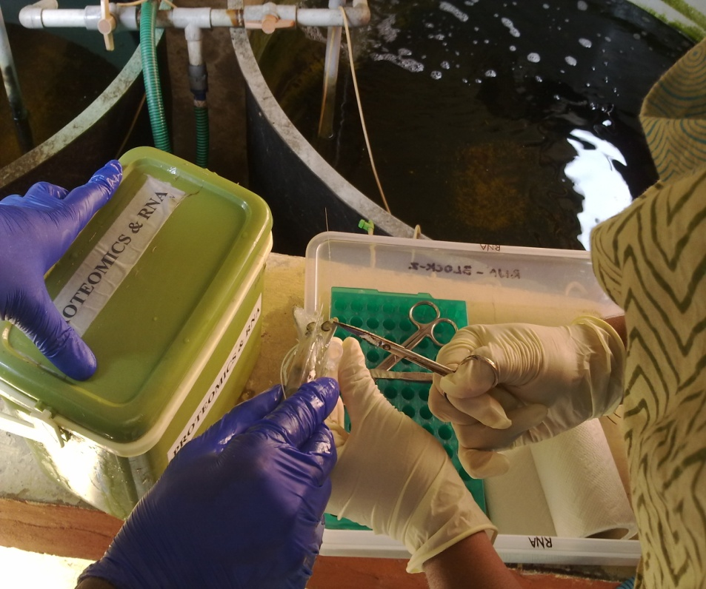
Broodstock maturation
Maturation is the first step in larval production and breeding of mature shrimp
It is designed either to maximize the production of nauplii or to allow for maximum control over mating and genetic crosses.
The process of eyestalk ablation
is used in shrimp maturation to
stimulate female shrimp to
develop mature ovaries and
spawn.

Slide 18
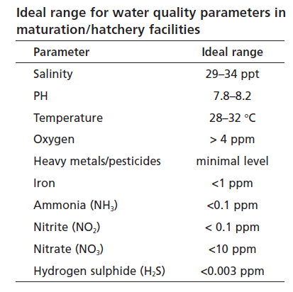

Slide 19
Broodstock Spawning
Spawning is the release of eggs and spermatozoa by the female into the water for fertilization.
The spermatophore which contains the spermatozoa is deposited in the female thelycum during copulation long before spawning.
For induced spawning the gravid female is then inspected to see if there is a spermatophore inside the thelycum.
If the spermatophore is present, the female should be disinfected with a formalin dip of 100 ppm for 3 min before being placed individually into the spawning tank.

Slide 20
CONT..
The females should then be left in peace to release their eggs.
The spawning tank water should be of good quality with maintained temperature and salinity .
Temperature: 28-32°c.
Salinity: 30-35ppt.
EDTA is often added to the spawning tank water as a heavy metal chelating agent.
Aeration.

Slide 21
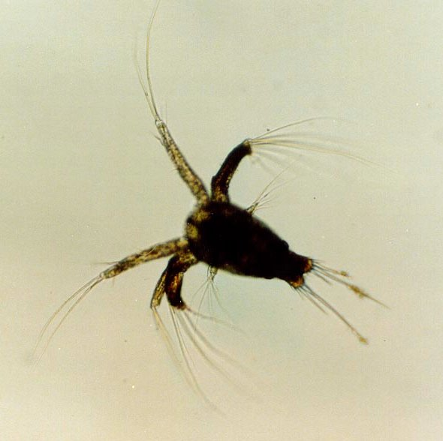
Egg hatching
Egg hatching should take place in a clean tank, away from the maturation and spawning tanks to avoid contamination.
Water quality should be maintained at 29–32°C and 32–35 ppt salinity for optimal hatching.
Very slight aeration until the nauplii hatch.
NAUPLII

Slide 22
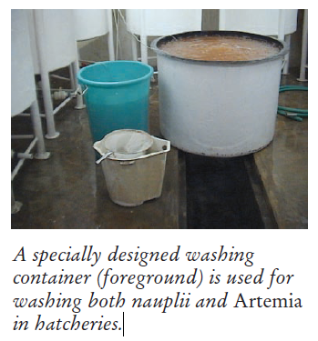
CONT..
The eggs are then transferred to the hatching tanks, which are prepared with 5–30 ppm EDTA and 0.05–0.1 ppm Treflan to remove heavy metals and fungi, respectively.
Nauplii display strong positive phototaxis.
Healthy nauplii can be harvested using a light to attract them to the water surface.

Slide 23
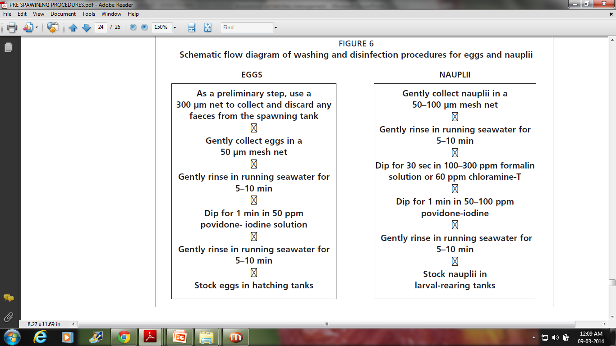

Slide 24
DISEASE TESTING
Once the healthy nauplii have been harvested, they can be checked for disease.
Test WSSV by PCR.
Test for bacterial (Vibrio spp.), fungal.
WSSV-positive nauplii should be rejected and destroyed by chlorinating at 500–1000 ppm.
The temperature and salinity in the holding tanks should be checked.
The nauplii are then ready to be transferred to the larval-rearing tanks.

Slide 25
IMPORTANT LARVAL DISEASES
Monodon baculovirus (MBV)
White Spot Syndrome Virus (WSSV)
Baculoviral midgut gland necrosis virus (BMNV)
Vibriosis (Vibrio)
Larval mycosis(Lagenidium and Sirolpidium spp.)
Ciliate infestation (Zoothamnium and Vorticella spp.)
Swollen hind gut (SHG)(causative agent not known)

Slide 26
Post- spawning procedures
Larval rearing unit preparation & management
The larvae is now transferred to nursery tanks.
Larval rearing unit
1st phase 2nd phase
Disinfectant should be used.
larvae are transferred to a ‘U’ or ‘V’ shaped bottom tank.
larvae are transferred to large, flat-bottomed tank for the PL culture and stoked until harvesting.

Slide 27
There are many factors involved in managing larval rearing and health in the hatchery:
reduce stress levels
Appropriate water exchange protocols
Siphoning of wastes
Aeration
Water quality monitoring- temperature, salinity, pH (7.8–8.2), ammonia(<0.1 ppm NH3), nitrite (<0.1 ppm NO2) and bacterial concentrations.

Slide 28
Larval nutrition and health management
All sources of live, fresh or frozen food should be considered from the point of view of pathogen risk.
Use of live/preserved algae.
Artemia is the most important food item available to the shrimp hatchery.
Artificial feeds.
Sufficient aeration should be provided to maintain the dry or liquid feed particles in suspension at all times.

Slide 29
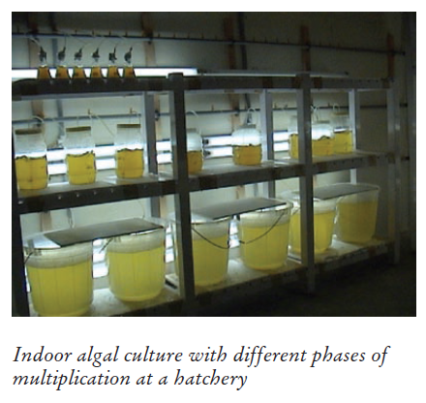
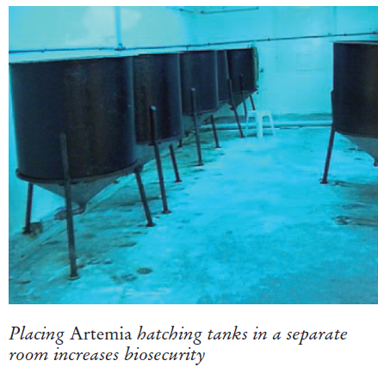

Slide 30
Testing/selection of post larvae
The PL quality assessment involves five main areas:
Gross examination:
(Size, color, activity, behavior, feeding and gut fullness)
Microscopic examination(40x):
(Gut condition, fouling, deformity)
Stress test:
(Salinity =28–32 ppt)
Vibrio test:
(To check for potentially harmful Vibrio spp. in the PL)
PCR screening:
(Testing for WSSV)

Slide 31
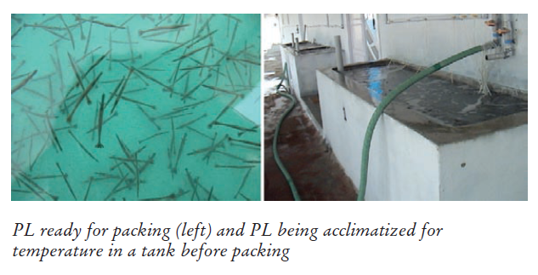
PL harvest and transportation
Done gradually and with minimal stress.
If possible the PL should be acclimated in the hatchery to the expected salinity in the on-growing farms (reduce the stress on stocking).
There are two main methods for PL transportation from the hatchery to the farm:
transported free in large, aerated tanks or
packed into plastic bags.
Temperature = low.

Slide 32
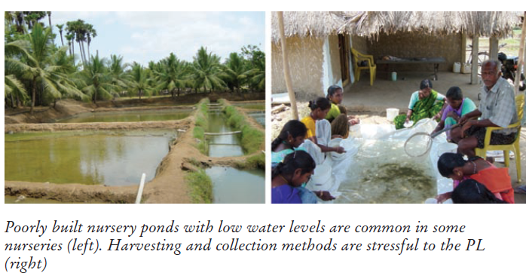
Nursery rearing facilities
PRIMARY NURSING
Transfer of young PL.
Kept only for 2 weeks.
Helps maintain clean culture facilities, as each tank is only stocked for a maximum of two weeks.
SECONDARY NURSING
Harvest of older PL.
Kept for 2 -3 weeks.
Enhance their fitness for stocking and minimize culture time in the ponds

Slide 33
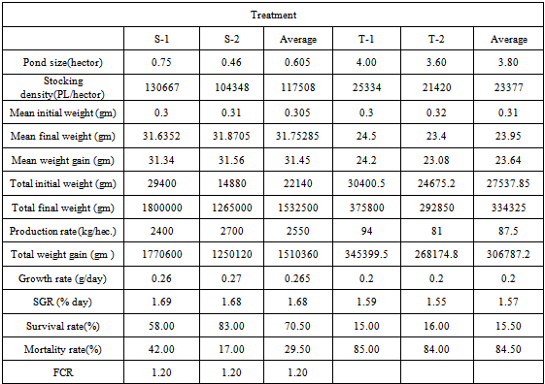
Average production rate, growth rate and survival rate of P.monodon

Slide 34
Refrences:
Gracia(1996)."White shrimp (Penaeus setiferus) recruitment overfishing". Marine and Freshwater Research 47 (1): 59–65.doi:10.1071/MF9960059.
Apud F, Primavera JH, Torres PL Jr. 1983. Farming of prawns and shrimps. Extension manual,no. 5, 3rd ed. Tigbauan, Iloilo: SEAFDEC Aquaculture Department. 67 p.
Israel DC, Agbayani RF, de la Pena DT Jr. 1986. Comparative economic analysis of different scales of prawn (Penaeus monodon) hatchery production systems. Asian Fisheries Social Science Research Network research report, no. 7. Tigbauan, Iloilo: AFSSRN-SEAFDEC AQD Team, SEAFDEC Aquaculture Department. 105 p.
Villegas CT, Ti TL, Kanazawa A. 1980. The effects of feeds and feeding levels in the survival of a prawn, Penaeus monodon larvae. Mem. Kagoshima Univ. Res. Cent. South.Pac. l(l):51-55.

Slide 35
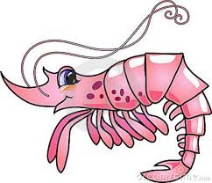
THANK YOU….

